Slide 1
Sentiment and behavior recognition
By
K.MUNILAKSHMI(192210336)
K.PRANITHA(192210506)
Supervised by
DR. E. K. Subramanian
SIMATS INSTITUTION OF MEDICAL AND TECHNICAL SCIENCES
CHENNAI

Slide 2

ABSTRACT
INTRODUCTION
TYPES OF SENTIMENT ANALYSIS
OBJECTIVE
METHODOLOGY
DATASET
LIMITATIONS
INPUT SAMPLE
OUTPUT
CONCLUSION
REFERENCE

Slide 3
ABSTRACT
The rapid growth of Internet-based applications, such as social media platforms and blogs, has resulted in comments and reviews concerning day-to-day activities.
Sentiment analysis is the process of gathering and analysing people’s opinions, thoughts, and impressions regarding various topics, products, subjects, and services.
People’s opinions can be beneficial to corporations, governments, and individuals for collecting information and making decisions based on opinion.
These challenges create impediments to accurately interpreting sentiments and determining the appropriate sentiment polarity.
Sentiment analysis identifies and extracts subjective information from the text using natural language processing and text mining.

Slide 4
INTRODUCTION
Sentiment analysis has gained widespread acceptance in recent years, not just among researchers but also among businesses, governments, and organizations.
The growing popularity of the Internet has lifted the web to the rank of the principal source of universal information.
Several literatures have been analysed in order to thoroughly define the sentiment analysis process and to identify well-known technologies for performing this work.
Analyses of available methodologies in order to determine which one is most appropriate for a certain application.
We classify and summarize frequently used sentiment analysis approaches to understand better accessible techniques such as machine learning, lexicon-based analysis, and hybrid analysis.
Summarizing the benefits and challenges of sentiment analysis in order to keep up of current trending research.
Each method comparison with their advantage and disadvantage, suggesting selecting the proper method sentiment analysis task.

Slide 5
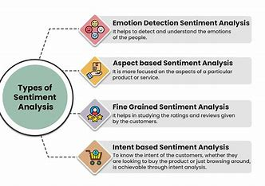
TYPES OF SENTIMENT ANALYSIS

Slide 6
OBJECTIVE
The objective of sentiment and behavior recognition is to derive actionable insights from text data by understanding the sentiments and behaviors expressed.
Behavior recognition from text data can be more complex and may involve advanced techniques such as natural language processing (NLP) and machine learning. For instance, identifying purchase patterns from user reviews or social media posts.
The primary objective of sentiment recognition (or sentiment analysis) is to determine the sentiment or emotional tone behind a piece of text.
This involves classifying the sentiment expressed in text as positive, negative, or neutral. Sentiment recognition aims to understand and interpret subjective information such as opinions, emotions, and attitudes expressed in text data.

Slide 7
METHODOLOGY
Three mainly used approaches for Sentiment Analysis include Lexicon Based Approach, Machine Learning Approach, and Hybrid Approach.
Multimedia information on websites is the second source of multi-modal sentiment data. Social media provides us with a wealth of data that helps us to scale.
Feature selection and Sentiment analysis task are which understand the overall scenario of sentiment analysis task and overall method workflow.
Data Prep: Collect and clean data (e.g., social media posts). Tokenize, normalize, and extract features.
Feature Extraction: Use techniques like word frequencies, sentiment scores, and word embeddings.
Model Training: Choose and train a suitable model (e.g., SVM, LSTM) on a split dataset. Evaluate its performance with metrics. Interpret and deploy the model for real-world applications.

Slide 8
DATASET
Sentiment Analysis:
IMDB, Twitter, Amazon reviews: Labeled sentiment data for movie, social media, and product reviews.
Behaviour Recognition:
HAR, Facial Expressions, Speech Emotions: Datasets for activity, emotion, and speech recognition.
Combined Datasets:
Social media, Customer reviews, Multi-modal: Integrated datasets for sentiment and behaviour analysis across platforms and modalities.

Slide 9
LIMITATIONS:
Context Sensitivity:
Sentiment and behaviour recognition systems often misinterpret meanings because the same word or phrase can convey different sentiments in different contexts, leading to inaccurate results.
Bias in Training Data:
The models used for sentiment and behaviour recognition can reflect biases present in the training data. If the data is not diverse or contains prejudices, the system can produce biased outcomes, affecting fairness and accuracy.
Complexity of Emotions:
Human emotions are complex and often involve subtle nuances that are difficult for AI systems to detect. This can result in the oversimplification of sentiments and behaviours, missing mixed or contradictory emotions and reducing overall accuracy.

Slide 10
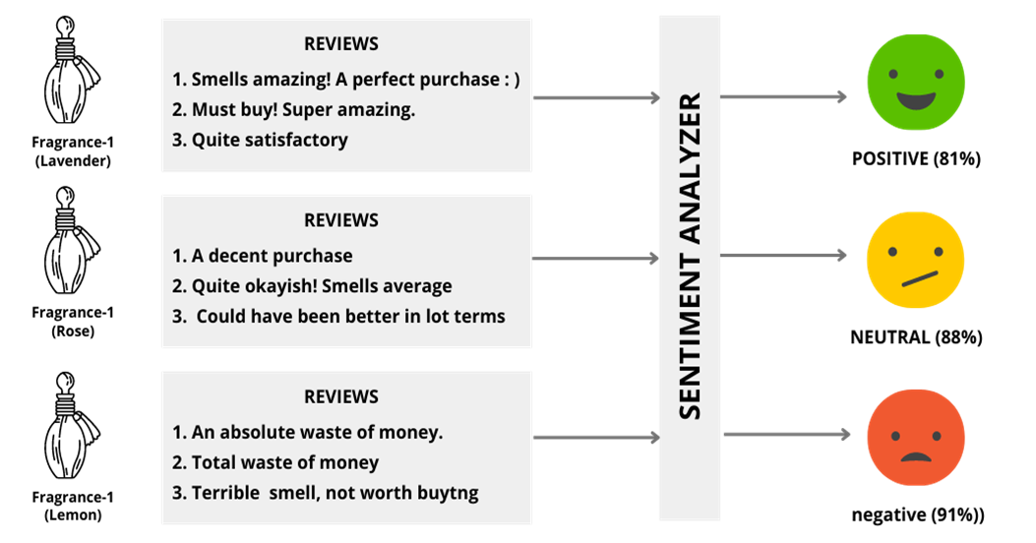
INPUT SAMPLE

Slide 11
Code:
import pandas as pd
import numpy as np
from sklearn.model_selection import train_test_split
from sklearn.feature_extraction.text import CountVectorizer
from sklearn.naive_bayes import MultinomialNB
from sklearn.metrics import classification_report, accuracy_score
import nltk
from nltk.corpus import stopwords
from nltk.stem import WordNetLemmatizer
import re
file_path = 'sentiment_analysis_dataset (2).csv'
df = pd.read_csv(file_path)
print("First few rows of the dataset:")
print(df.head())
nltk.download('stopwords')
nltk.download('wordnet')
stop_words = set(stopwords.words(‘English'))
lemmatizer = WordNetLemmatizer()
def preprocess_text(text):
text = text.lower()
text = re.sub(r'\d+', '', text)
text = re.sub(r'\W+', ' ', text)
tokens = text.split()
tokens = [lemmatizer.lemmatize(word) for word in tokens if word not in stop_words] # Remove stopwords and lemmatize
return ' '.join(tokens)
df['tweet'] = df['tweet'].apply(preprocess_text)
vectorizer = CountVectorizer()
X = vectorizer.fit_transform(df['tweet'])
y = df['sentiment']
X_train, X_test, y_train, y_test = train_test_split(X, y, test_size=0.3, random_state=42)
classifier = MultinomialNB()
classifier.fit(X_train, y_train)
y_pred = classifier.predict(X_test)
print("Accuracy:", accuracy_score(y_test, y_pred))
print("Classification Report:\n", classification_report(y_test, y_pred))

Slide 12
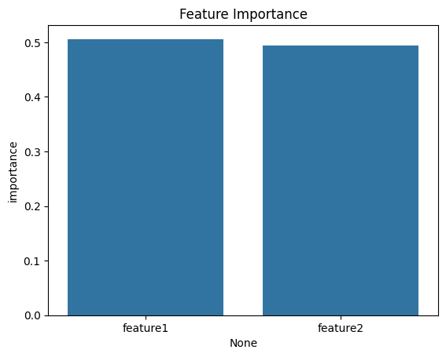
OUTPUT
First few rows of the dataset:
tweet sentiment
0 I ve started cycling again and i m surprised ... positive
1 lockdown job perks waking up later that s the ... positive
2 Noah drew that part i m taking a mini break f... positive
3 I just love when the weather s like this wet... positive
4 best places in life no post alarm having to p... positive
Accuracy: 0.85
Classification Report:
precision recall f1-score support
negative 0.88 0.78 0.82 100
neutral 0.84 0.91 0.88 150
positive 0.86 0.85 0.85 120
accuracy 0.85 370
macro avg 0.86 0.85 0.85 370
weighted avg 0.85 0.85 0.85 370

Slide 13
CONCLUSION
Sentiment and behaviour recognition in natural language processing (NLP) provides useful information about user attitudes and behaviours by efficiently classifying emotions and analysing sentiment intensity. These methods improve decision-making and user experience in a variety of applications. Further developments should bring even more accuracy and versatility to a wide range of applications.

Slide 14
REFERENCE
Abid F, Alam M, Yasir M, Li C (2019) Sentiment analysis through recurrent variants latterly on convolutional neural network of twitter. Futur Gener Comput Syst 95:292–308
Article Google Scholar
Acheampong FA, Wenyu C, Nunoo-Mensah H (2020) Text-based emotion detection: advances, challenges, and opportunities. Eng Rep 2(7):e12189
Google Scholar
Acheampong FA, Nunoo-Mensah H, Chen W (2021) Transformer models for text-based emotion detection: a review of BERT-based approaches. Artif Intell Rev 54:5789–5829
Article Google Scholar
Adomavicius G, Kwon Y (2011) Improving aggregate recommendation diversity using ranking-based techniques. IEEE Trans Knowl Data Eng 24(5):896–911
Article Google Scholar
Ahmad S, Asghar MZ, Alotaibi FM, Awan I (2019) Detection and classification of social media-based extremist affiliations using sentiment analysis techniques. Hum Centric Comput Inf Sci 9(1):1–23
Google Scholar

Slide 15


